Slide 1
Analysis
Chapter 5

Slide 2
Analysis focuses on producing a model of the system, called the analysis model, which is correct, complete, consistent, and verifiable

Slide 3
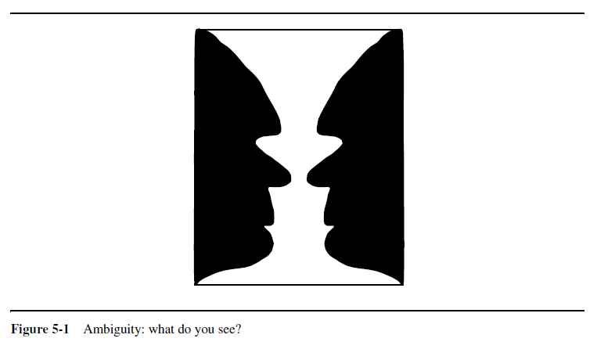

Slide 4
Outlines for two weeks
Introduction
Overview of Analysis
We focus on:
Identification of Objects
Entity, boundary and control objects
Abbott’s technique
Helps in object identification.
Objects relationship
Identifying Associations., Aggregates , Attributes
Objects behaviors
Mapping use cases to Object with Sequence Diagrams
Modeling state Dependent Behavior of Individual Object
Analysis Activities (UML Activities Diagram)
An Example
Managing Analysis
Review the Analysis Model

Slide 5
Introduction
What is analysis?
Analysis focuses on producing a model of the system, called analysis model
Analysis modeling uses a combination of text and diagrammatic forms to show requirements for a system.
Who does this?
Software Engineer builds the model by using requirements elicited from the customer
Why is it important?
To validate the software
To find the errors
How do we know we have done it right?
The model must be reviewed for correctness, completeness, and consistency

Slide 6
Overview of Analysis
Analysis model is the first technical representation of a system
The model must be:
Correct
Complete
Verifiable
The analysis model must achieve four primary objectives
Describe what the customer requires
Establish a basis for creation of software design
Define a set of requirements that can be validated once the software is built
Bridge the gap between system description and software design

Slide 7
Overview of Analysis
Developers formalize the requirements specification produced during requirements elicitation
Developers examine in more detail boundary conditions and exceptional cases.
Developers validate, correct and clarify the requirements specification if any errors or ambiguities are found.
The client and the user are usually involved in this activity when the requirements specification must be changed and when additional information must be gathered.
In object-oriented analysis, developers build a model describing the application domain.

Slide 8
Cont.(Overview of Analysis)
Analysis Model is Composed of three individual models;
The functional model
Represented by use cases and scenarios
The analysis object model
Represented by state class and object diagrams
Dynamic model
Represented by state machine and sequence diagrams
System modeling = Functional modeling + Object modeling + Dynamic modeling

Slide 9
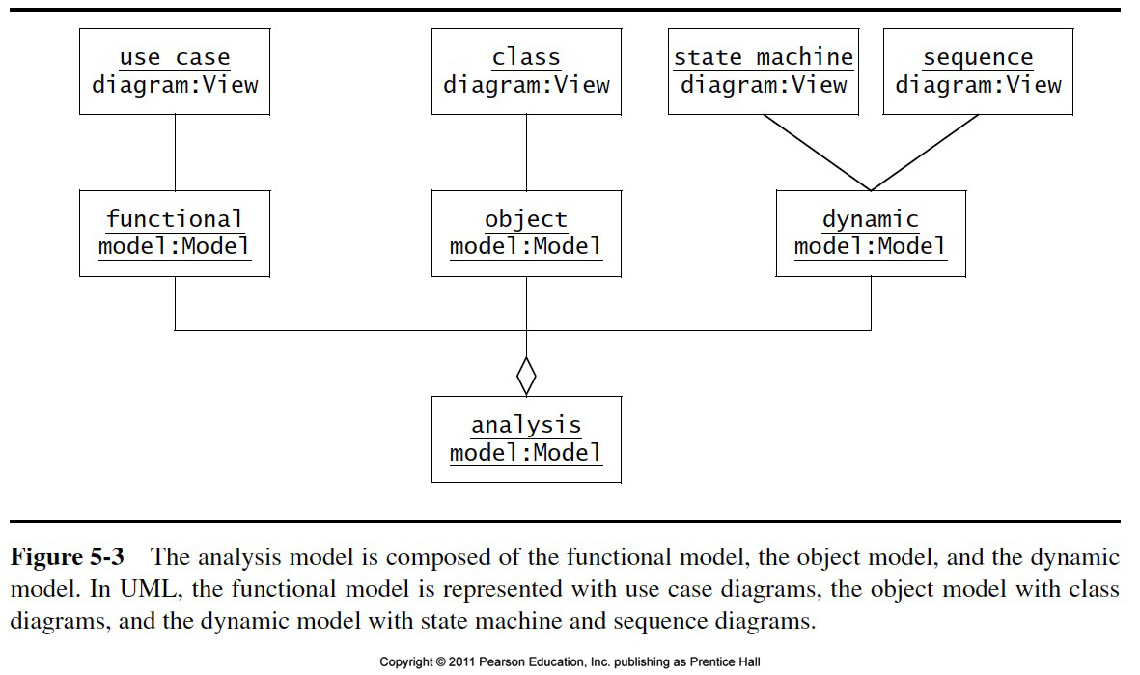

Slide 10
Elements of Analysis Model
Behavioral Modeling
Define state diagrams, sequence diagrams
Scenario based modeling
Represents the system from the user’s point of view
Flow oriented modeling
Provides an indication of how data objects are transformed by processing functions
Class based modeling
Defines objects, attributes, and relationships

Slide 11
Analysis Object Models and Dynamic Models
Analysis Object Model focuses on;
The concepts
Their properties
Their relationship
Shown with class diagrams
Analysis Dynamic Model focuses on
The behavior of the system
Shown with sequence diagrams and state machine
These models (Dynamic and Object) represent user-level concepts, not actual software classes or components

Slide 12
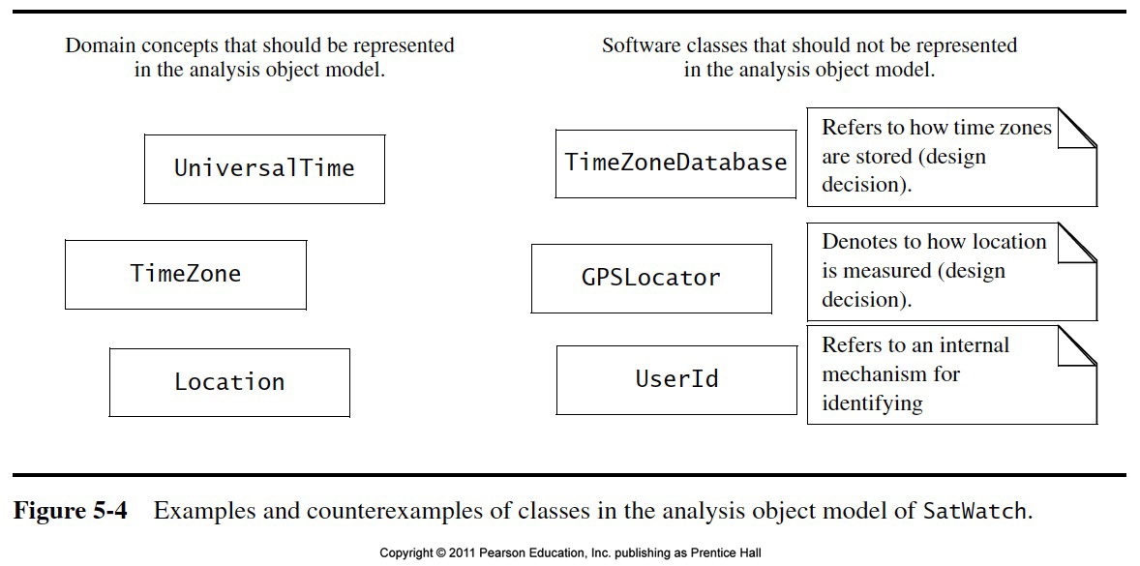

Slide 13
Activities during Object Modeling
Main goal: Find the important abstractions
Steps during object modeling
1. Class identification
Based on the fundamental assumption that we can find abstractions
2. Find the attributes
3. Find the methods
4. Find the associations between classes
Goal: get the desired abstractions
What happens if we find the wrong abstractions?
We iterate and revise the model
Notes:
Start with review: What is a model? What is an abstraction? They are used synonomously and mean they provide a simplified view of a complex system that we cannot understand by looking at all of its components simultaneously. Models by their definition abstract away important characteristics of a system by emphasizing other aspects.
Example: Clay model concentrates on the form of the car, nobody can sit in it.
Prototypes are models.
Iterate and correct the model: A scientific model is always like a hypothesis. The important part of a scientific model is that it is falsifiable. This is an important aspect of prototyping. They are immediately understandable and can be falsified (that is our theory of how the application should work!). This is one of the main strengths of prototyping: End user falsifiability.
Redesign (Falsification principle in science: Work with model until it is proven to be false)

Slide 14
There are different types of Objects
Entity Objects
Represent the persistent information tracked by the system (also called Application models or “Business objects”).
These objects represent things that are to be stored in a database.
Boundary Objects
Represent the interaction between the user and the system
Boundary Objects are used to create interfaces such as interactive screens , printing reports, etc.
Boundary Objects are designed with the responsibility of managing the way entity objects are represented to users
Notes:
Be prepared that some objects are still missing and need to be found:
Model the flow of events with a sequence diagram
Always use the clients or end users terminology

Slide 15
Cont.. (Types of Objects)
Control Objects
Represent the control tasks performed by the system.
Manage a unit of work from start to the finish
To create or update of entry objects
The instantiation of boundary objects as they obtain information from entity objects.
Complex communication between sets of objects
Validate the data communication

Slide 16
Heuristics to identify entity Objects
Terms need to understand the use case
Check the nouns in the use cases (e.g. Incidents)
Real-world entities that the system needs to track (e.g. FieldOfficer)
Real-world activities that the system needs to track (EmergencyOperationPlan)
Data source

Slide 17
Heuristics to identify Boundary Objects
Identify user interface control
Identify forms
Identify notices
When multiply actors are involved identify actor terminal
Always use the end user terms for describing interfaces
Heuristics to identify Control Objects
Identify one control object per use case
Identify one control object per actor in the use case

Slide 18
Example: 2BWatch Modeling
To distinguish different object types
in a model we can use the
UML Stereotype mechanism
Year
Button
ChangeDate
Month
LCDDisplay
Day
Entity Objects
Control Object
Boundary Objects

Slide 19
Naming Object Types in UML
UML provides the stereotype mechanism to introduce new types of modeling elements
A stereotype is drawn as a name enclosed by angled double-quotes (“guillemets”) (<<, >>) and placed before the name of a UML element (class, method, attribute, ….)
Notation: <<String>>Name
<<Entity>>
Year
<<Boundary>>
Button
<<Control>>
ChangeDate
<<Entitity>>
Month
<<Boundary>>
LCDDisplay
<<Entity>>
Day
Entity Object
Control Object
Boundary Object

Slide 20
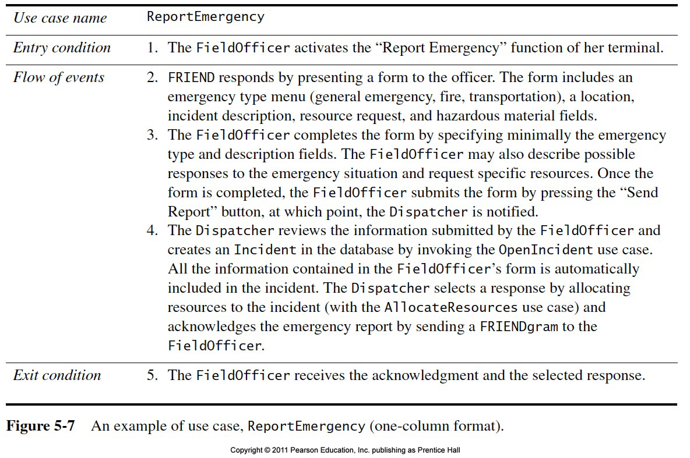

Slide 21
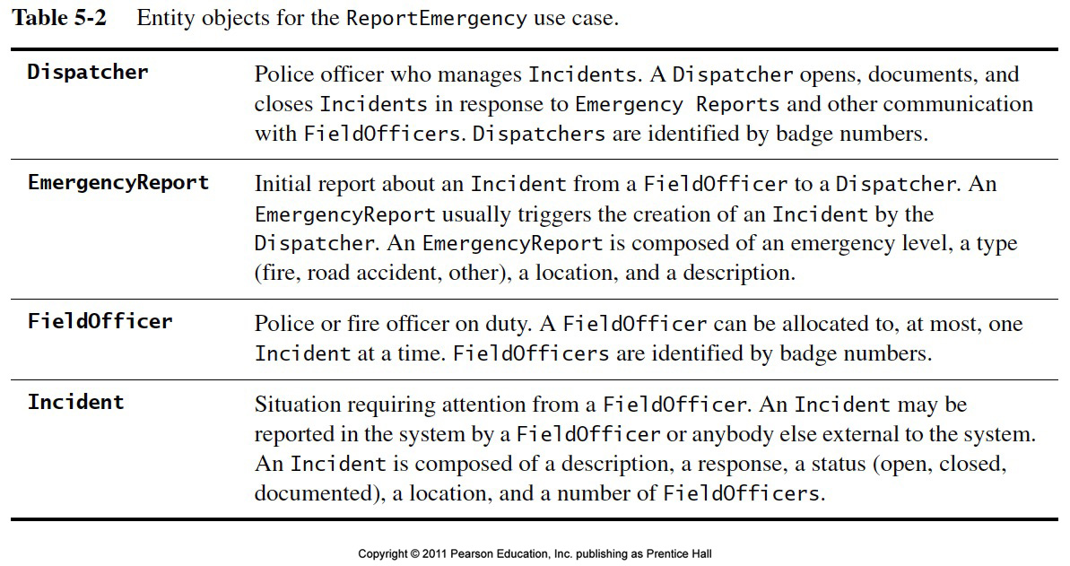

Slide 22
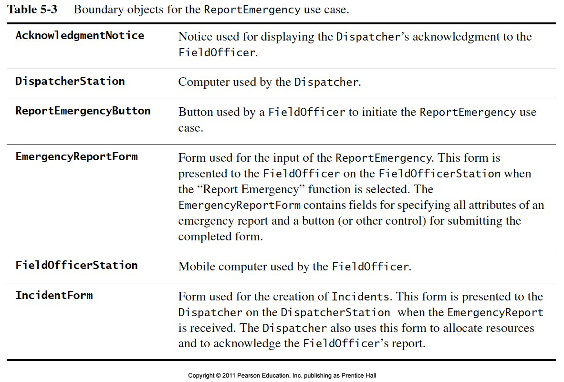

Slide 23
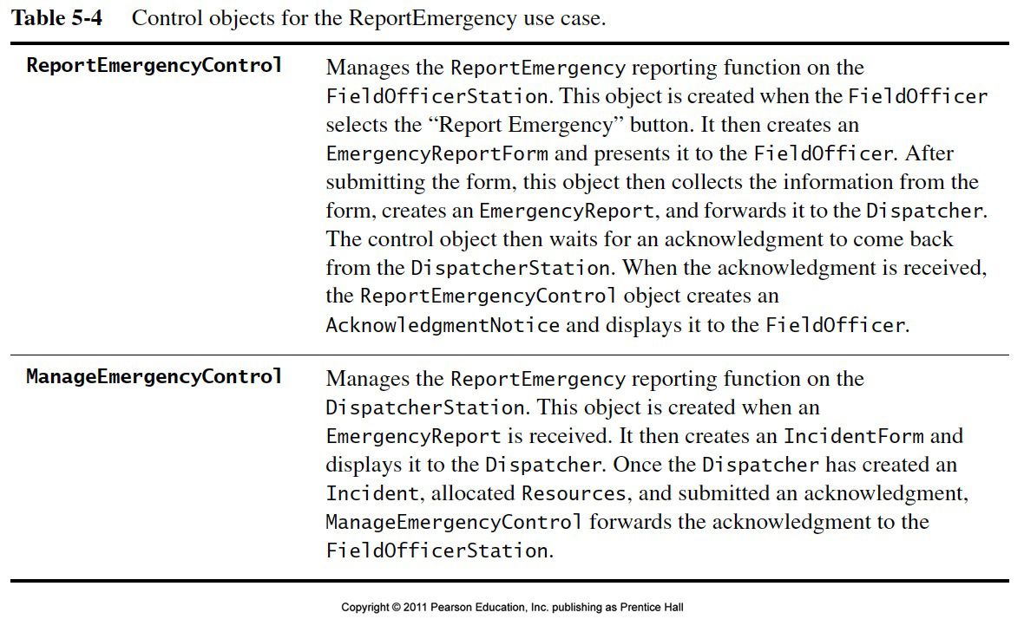

Slide 24
Object Types allow us to deal with Change
Having three types of object leads to models that are more resilient to change
The interface of a system changes more likely than the control
The way the system is controlled changes more likely than entities in the application domain
Object types originated in Smalltalk:
Model, View, Controller (MVC)
Model <-> Entity Object
View <-> Boundary Object
Controller <-> Control Object
Notes:
Approach: Finding Participating Objects in Use Cases

Slide 25

Cite: http://en.wikipedia.org/wiki/Model%E2%80%93view%E2%80%93controller#mediaviewer/File:MVC-Process.svg

Slide 26
Generalization and Specialization
Inheritance enables us to organize concepts into hierarchies
The top of the hierarchy is a general concept
The bottom of the hierarchy are the most specialized concept
There might be intermediate levels in between
Generalization is the modeling activity that identifies abstract concept
Specialization is the activity that identifies mode specific concepts

Slide 27
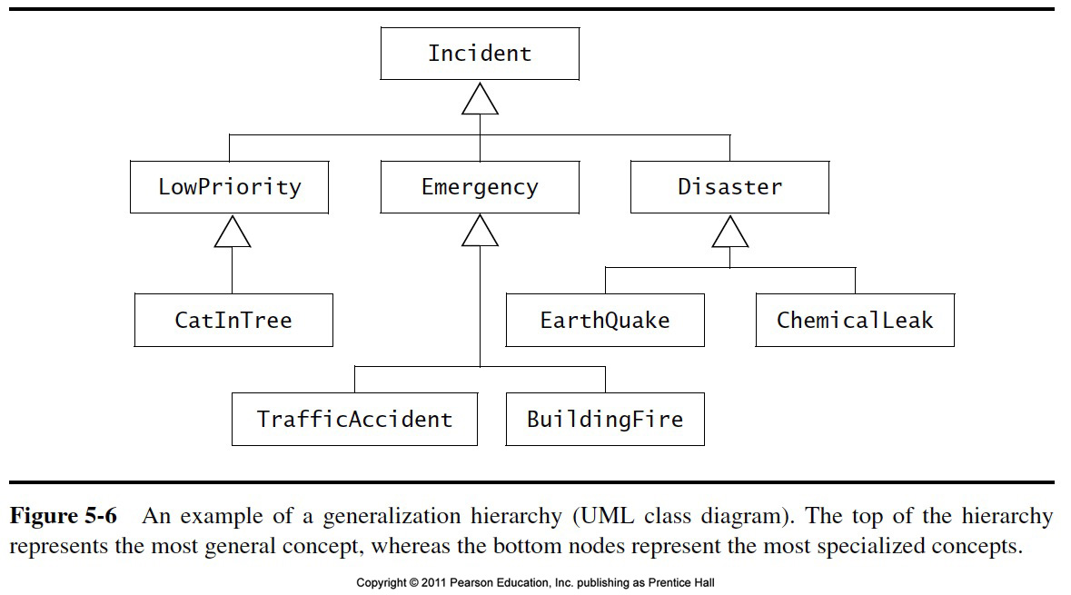

Slide 28
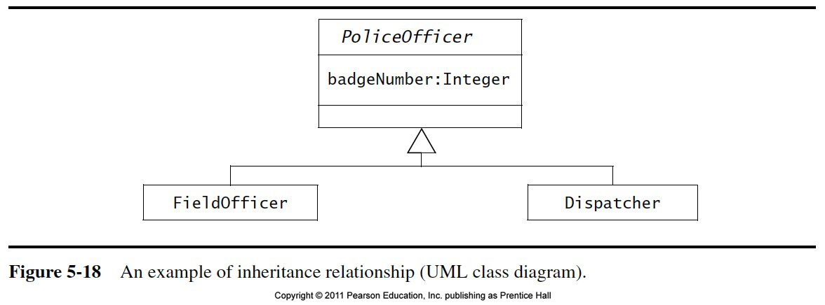

Slide 29
Class Identification
Class identification is crucial to object-oriented modeling
Helps to identify the important entities of a system
Basic assumptions:
1. We can find the classes for a new software system (Forward Engineering)
2. We can identify the classes in an existing system (Reverse Engineering)

Slide 30
Ways to find Objects
Syntactical investigation with Abbott‘s technique:
Flow of events in use cases
Problem statement
Use other knowledge sources:
Application knowledge: End users and experts know the abstractions of the application domain
Solution knowledge: Abstractions in the solution domain
General world knowledge: Your generic knowledge and intuition
Notes:
Goal: Come up with
> a domain model (domain specific objects)
a taxonomy (class hierarchy)
Syntactical investigation with Abbot‘s techniqe:
In the problem statement (originally proposed, but rarely works if the problem statement is large (more than 5 pages)
In the flow of events of use cases
=> Textuelle Analyse nach Abbot
Use of various knowledge sources:
Application knowledge: Interviews of end users and experts, to determine the abstractions of the application domain.
Design knowledge: Reusable abstractions in the solution domain.
General world knowledge: Also use your generic knowledge and intution.
Formulation of scenarios (in natural language):
Description of the concrete usage of the system.
Formulation of use cases (natural language and UML):
Description of functions with actors and flow of events

Slide 31
Order of Activities for Object Identification
Formulate a few scenarios with help from an end user or application domain expert
Extract the use cases from the scenarios, with the help of an application domain expert
3. Then proceed in parallel with the following:
Analyze the flow of events in each use case using Abbot's textual analysis technique
Generate the UML class diagram.
Notes:
Generating class diagrams involves a couple of steps, shown on the next slide

Slide 32
Steps in Generating Class Diagrams
Class identification (textual analysis, domain expert)
Identification of attributes and operations (sometimes before the classes are found!)
Identification of associations between classes
Identification of multiplicities
Identification of roles
Identification of inheritance
Notes:
This is a list of activities you need to perform when generating class diagrams, not necessarily in this order.

Slide 33
Finding Participating Objects in Use Cases
Pick a use case and look at flow of events
Do a textual analysis (noun-verb analysis)
Nouns are candidates for objects/classes
Verbs are candidates for operations
This is also called Abbott’s Technique
After objects/classes are found, identify their types
Identify real world entities that the system needs to keep track of (FieldOfficer  Entity Object)
Identify real world procedures that the system needs to keep track of (EmergencyPlan  Control Object)
Identify interface artifacts (PoliceStation  Boundary Object).
Notes:
Take the flow of events and find participating objects in use cases and scenarios (flow of events)
This technique can also be used to do a textual analysis of the whole problem statement, but that is quite an undertaking. When analysing only event flows, we have a better focus and the technique is more useful
Pick a use case and look at flow of events
Find terms that need to be clarified in order to understand the flow of events
Look for recurring nouns (e.g., Incident)
Identify real world entities that the system needs to keep track of (e.g., FieldOfficer)
Identify real world procedures that the system needs to keep track of (e.g., EmergencyOperationsPlan)
Identify interface artifacts (e.g., PoliceStation)
Be prepared that some objects are still missing and need to be found:
Model the flow of events with a sequence diagram
Always try to use the clients or end users terminology

Slide 34
Example for using the Technique
Flow of Events:
The customer enters the store to buy a toy.
It has to be a toy that his daughter likes and it must cost less than 50 Dollars
He tries a videogame, which uses a data glove and a head-mounted display. He likes it.
An assistant helps him.
The suitability of the game depends on the age of the child.
His daughter is only 3 years old.
The assistant recommends another type of toy, namely the boardgame “Monopoly".
Notes:
Question: Is this a good use case flow of events description? Answer: Not quite., the whole event flow actually reads more as if it is still a scenario “Monopoly” is probably a left over from the scenario
Question: Does the event flow finish correctly? Answer: The description should terminate with the customer leaving the store

Slide 35
Mapping parts of speech to model components (Abbott’s Technique)
Example
Part of speech
UML model component
“Monopoly”
Proper noun
object
Toy
Improper noun
class
Buy, recommend
Doing verb
operation
is-a
being verb
inheritance
has an
having verb
aggregation
must be
modal verb
constraint
dangerous
adjective
attribute
enter
transitive verb
operation
depends on
intransitive verb
Constraint, class,
association
Notes:
First proposed by Abbot in an article for the Communication of the ACM in 1983

Slide 36
Generating a Class Diagram from Flow of Events
Flow of events:
Customer
store
toy
customer enters
buy
The customer enters the store to buy a toy. It has to be a toy that his daughter likes and it must cost less than $50. He tries a videogame, which uses a data glove and a head-mounted display. He likes it.
?
enter()
store
enter()
daughter
videogame
less than 50
daughter
daughter
age
An assistant helps him. The suitability of the game depends on the age of the child. His daughter is only 3 years old. The assistant recommends another type of toy, namely a boardgame. The customer buy the game and leaves the store
depends
age
suitable
Toy
price
buy()
like()
*
type of toy
toy
buy()
toy
boardgame
videogame
boardgame

Slide 37
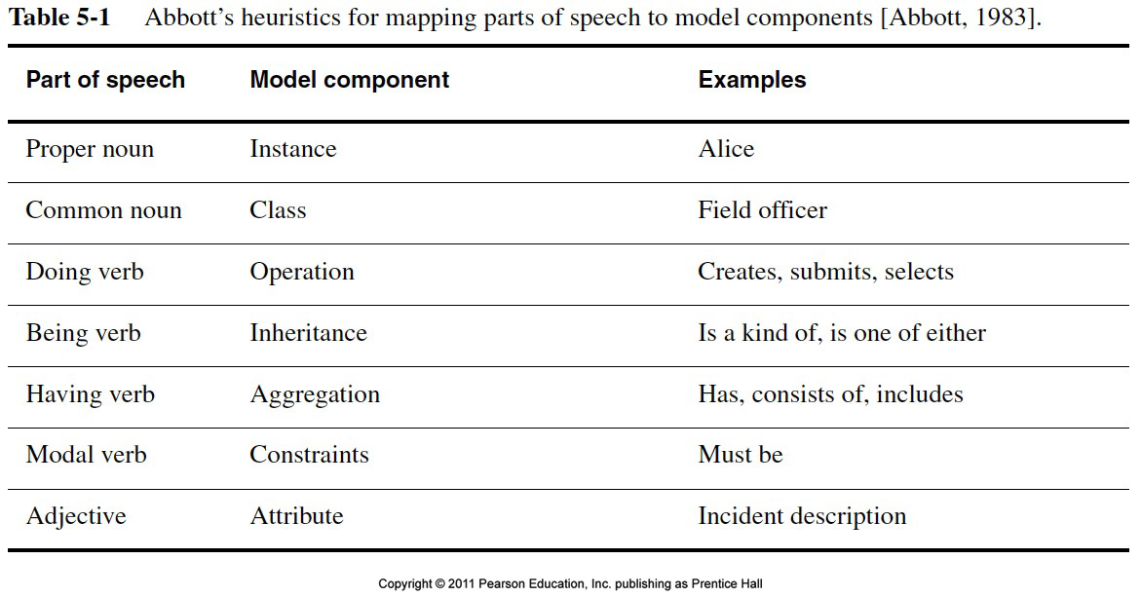

Slide 38
Who uses Class Diagrams?
Purpose of class diagrams
The description of the static properties of a system
The main users of class diagrams:
The application domain expert
uses class diagrams to model the application domain (including taxonomies)
during requirements elicitation and analysis
The developer
uses class diagrams during the development of a system
during analysis, system design, object design and implementation.

Slide 39
Who does not use Class Diagrams?
The client and the end user are usually not interested in class diagrams
Clients focus more on project management issues
End users are more interested in the functionality of the system.

Slide 40
Overview of Previous Classes
Scenarios (Chapter 1, 2,4)
Finding Scenarios
Identifying actors
Use Cases (Chapter 1, 2,4)
Finding Use Cases
Flow of Events
Use Case Associations
Use Case Refinement
Object Model:
Identification of Objects (Entity, boundary and control objects )
Abott’s technique (Helps in object identification)
Objects relationship (Identifying Associations, Aggregates , Attributes )

Slide 42
Lecture 5th (Objects Behaviors )
Dynamic modeling
Interaction Diagrams
Sequence diagrams
Collaboration diagrams
State diagrams
Managing Analysis

Slide 43
Associations
Types of Associations
Canonical associations
Part-of Hierarchy (Aggregation)
Kind-of Hierarchy (Inheritance)
Generic associations

Slide 44
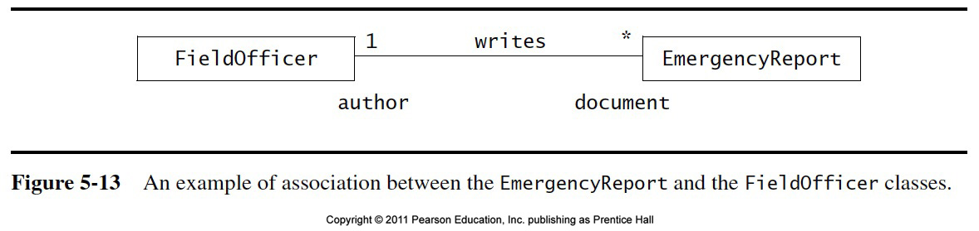

Slide 45
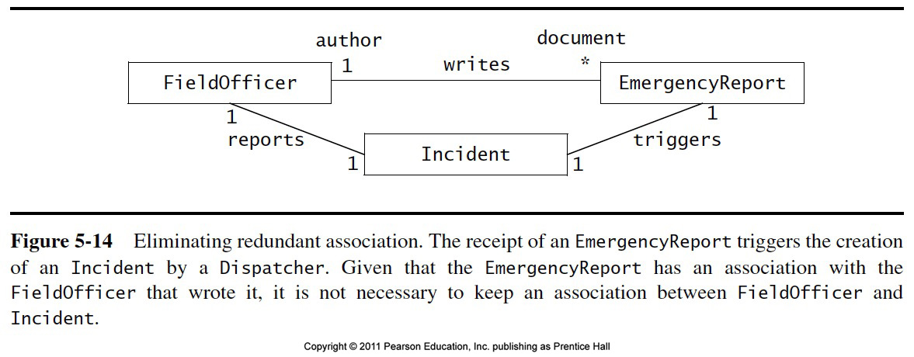

Slide 46
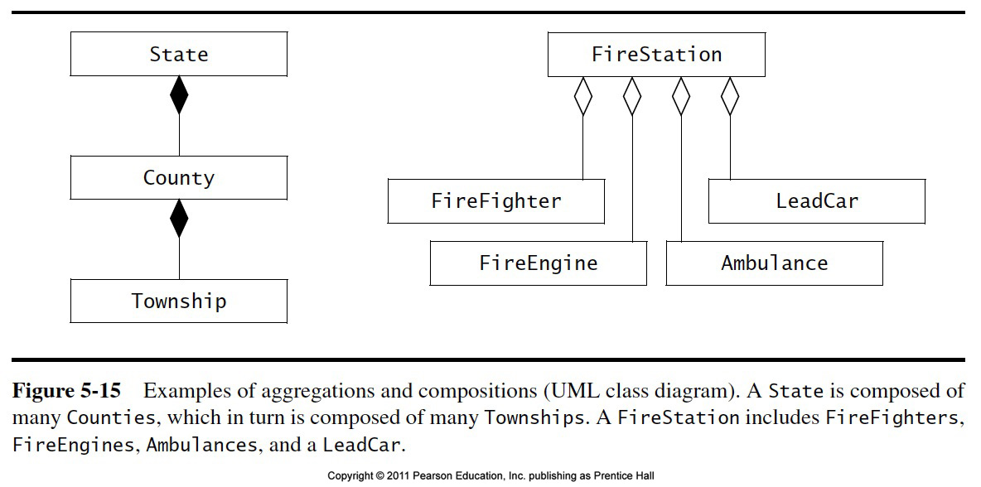

Slide 47
Object Modeling in Practice: More classes
Account
Amount
Customer
Bank
AccountId
CustomerId
Name
Name
Deposit()
CustomerId
Withdraw()
GetBalance()
1) Find New Classes
2) Review Names, Attributes and Methods

Slide 48
Object Modeling in Practice: Associations
Account
?
*
Amount
*
Customer
Bank
AccountId
owns
has
CustomerId
AccountId
Name
Deposit()
2
Name
CustomerId
Withdraw()
GetBalance()
1) Find New Classes
2) Review Names, Attributes and Methods
3) Find Associations between Classes
4) Label the generic assocations
5) Determine the multiplicity of the assocations
6) Review associations

Slide 49
Practice Object Modeling: Find Taxonomies
Account
Bank
Customer
*
Amount
*
Name
Has
Name
AccountId
CustomerId
AccountId
Deposit()
Withdraw()
GetBalance()
CustomerId()
Savings
Account
Checking
Account
Mortgage
Account
Withdraw()
Withdraw()
Withdraw()

Slide 50
Practice Object Modeling: Simplify, Organize
Account
Amount
Show Taxonomies
separately
AccountId
CustomerId
AccountId
Deposit()
Withdraw()
GetBalance()
Savings
Account
Checking
Account
Mortgage
Account
Withdraw()
Withdraw()
Withdraw()

Slide 51
Attributes
Detection of attributes is application specific
Attributes in one system can be classes in another system
Turning attributes to classes and vice versa

Slide 52
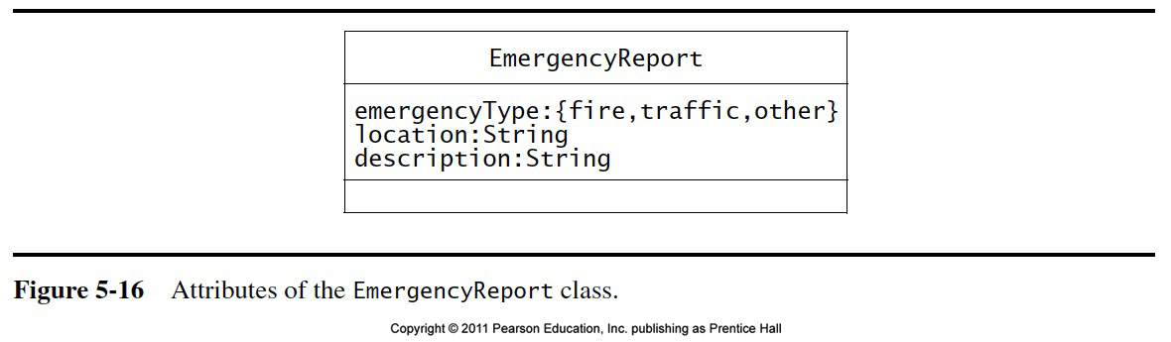

Slide 53
Operations
Source of operations
Use cases in the functional model
General world knowledge
Generic operations: Get/Set
Design Patterns
Application domain specific operations
Actions and activities in the dynamic model

Slide 54
Object vs Class
Object (instance): Exactly one thing
This lecture on object modeling
A class describes a group of objects with similar properties
Game, Tournament, mechanic, car, database
Object diagram: A graphical notation for modeling objects, classes and their relationships
Class diagram: Template for describing many instances of data. Useful for taxonomies, patters, schemata...
Instance diagram: A particular set of objects relating to each other. Useful for discussing scenarios, test cases and examples
Notes:
Tool for building object diagrams, in particular class diagrams
CASE (Computer-Aided Software Engineering) Tools
Together, Rationale Rose

Slide 55
Developers have different Views on Class Diagrams
According to the development activity, a developer plays different roles:
Analyst
System Designer
Object Designer
Implementer
Each of these roles has a different view about the class diagram (the object model).
Notes:
In small system developments some of the roles do not exist or are played by the same person.
Before I describe these different views, let us review the types of classes that appear in class diagrams
Application domain classes
Solution domain classes

Slide 56
The View of the Analyst
The analyst is interested
in application classes: The associations between classes are relationships between abstractions in the application domain
operations and attributes of the application classes
The analyst uses inheritance in the model to reflect the taxonomies in the application domain
Taxonomy: An is-a-hierarchy of abstractions in an application domain
The analyst is not interested
in the exact signature of operations
in solution domain classes

Slide 57
The View of the Designer
The designer focuses on the solution of the problem, that is, the solution domain
The associations between classes are now references (pointers) between classes in the application or solution domain
An important design task is the specification of interfaces:
The designer describes the interface of classes and the interface of subsystems
Subsystems originate from modules.
Module: a collection of classes
Subsystem: a collection of classes with an interface
Subsystems are modeled in UML with a package.
Notes:
The designer describes the interface of classes (object designer) and the interface of subsystems (system designer)

Slide 58
The View of the Implementor
Class implementer
Must realize the interface of a class in a programming language
Interested in appropriate data structures (for the attributes) and algorithms (for the operations)
Class extender
Interested in how to extend a class to solve a new problem or to adapt to a change in the application domain
Class user
The class user is interested in the signatures of the class operations and conditions, under which they can be invoked
The class user is not interested in the implementation of the class.
Notes:
The Class implementor implements the class
Class-user (often calso called client): The programmer, who wants to use an existing class (e.g. a clas from a class library or a class from another subsystem)

Slide 59
Object Modeling
Class based modeling (object modeling) represents the objects that system will manipulate, the operation that will be applied to the objects. The elements of class based modeling are;
Objects
Attributes of objects,
Methods of objects
Relationships between objects
To create an Object model of a system you must define all these elements of the system.

Slide 61
Dynamic Modeling
The behavior of a system can be represented as a function of specific events and time. The dynamic or behavioral model indicates how software will respond to external events. To create a dynamic model you should perform the following steps;
Evaluate all use cases to fully understand the sequence of interaction within the system
Identify events that drive the interaction sequence and understand how these events relates to specific objects
Create a sequence for each use case
Build a state diagram for the system
Review the behavior model to verify accuracy and consistency

Slide 62
Dynamic Modeling with UML
Two UML diagrams types for dynamic modeling:
Interaction diagrams describe the dynamic behavior between objects
State machine diagrams describe the dynamic behavior of a single object.
Notes:
Parts of the DAIMLER system has a rich dynamic behavior, so the dynamic model is important.
Note that the dynamic model is an abstraction like the other models as well. Depending on what properties are most characteristic in a system, one of the models will be richer or more significant than others. If you have a choice to decide on a single model, which one would you use?
Object Model: Database, Preventive maintenance,
Dynamic Model: Communication, Notification Server, AGTS Server, Change management (Information flow!)
Temporal relationships are difficult to understand. Rumbaugh thinks, that a system can be best understood by first examining its static structure, that is the structure of its objects and their relationships to each other at a single moment in time. Then we examine the changes to the objects and their relationships over time. (Note that not everybody thinks that way. Heraklit: Everything flows (requires dynamic modeling first), Jacobsen: Use cases (Functional description)
Control is that aspect of a system that describes the sequences of operations that occur in response to external stimuli, without consideration of what the operations do, what the operate on or how they are implemented.
The major concepts of dynamic modeling are events which represent external stimuli and states, which represent the values of objects.
We will use state diagrams, which are a standard computer science concept. Question: Who does not know what a finite state automaton is?
In general we assume, that FSA are covered in 15-211 (Algorithms and Datastructures)
Similar to the problem in object modeling, we need to avoid to clutter our state diagrams (spaghetti diagrams). We will show that states and events can be organized into generalization hierarchies that share structure and behavior.

Slide 63
UML Interaction Diagrams
Two types of interaction diagrams:
Sequence Diagram:
Describes the dynamic behavior of several objects over time
Good for real-time specifications
Collaboration Diagram:
Shows the temporal relationship among objects
Position of objects is based on the position of the classes in the UML class diagram.
Does not show time
Notes:
Sequence Diagram:
Describes the dynamic behavior of a set of objects arranged in time sequence.
Good for real-time specifications and complex scenarios

Slide 64
UML State Chart Diagram
State Machine Diagram:
A state machine that describes the response of an object of a given class to the receipt of outside stimuli (Events).
Activity Diagram:
A special type of state chart diagram, where all states are action states (Moore Automaton).
Notes:
Sequence Diagram:
Describes the dynamic behavior of a set of objects arranged in time sequence.
Good for real-time specifications and complex scenarios

Slide 65
Dynamic Modeling
Definition of a dynamic model:
Describes the components of the system that have interesting dynamic behavior
The dynamic model is described with
State diagrams: One state diagram for each class with interesting dynamic behavior
Classes without interesting dynamic behavior are not modeled with state diagrams
Sequence diagrams: For the interaction between classes
Purpose:
Detect and supply operations for the object model.

Slide 66
How do we detect Operations?
We look for objects, which are interacting and extract their “protocol”
We look for objects, who have interesting behavior on their own
Good starting point: Flow of events in a use case description
From the flow of events we proceed to the sequence diagram to find the participating objects.

Slide 67
What is an Event?
Something that happens at a point in time
An event sends information from one object to another
Events can have associations with each other:
Causally related:
An event happens always before another event
An event happens always after another event
Causally unrelated:
Events that happen concurrently
Events can also be grouped in event classes with a hierarchical structure => Event taxonomy

Slide 68
Sequence Diagram
A sequence diagram is a graphical description of the objects participating in a use case using a DAG notation
Heuristic for finding participating objects:
A event always has a sender and a receiver
Find them for each event => These are the objects participating in the use case.
Sequence diagrams are derived from use cases
Notes:
From the flow of events in the use case or scenario we proceed to the sequence diagram
A sequence diagram is a graphical description of objects participating in a use case or scenario using a DAG (direct acyclic graph) notation
Heuristic for finding participating objects:
A event always has a sender and a receiver.
The representation of the event is sometimes called a message
Find them for each event => These are the objects participating in the use case
Relation to object identification:
Objects/classes have already been identified during object modeling
Objects are identified as a result of dynamic modeling

Slide 70
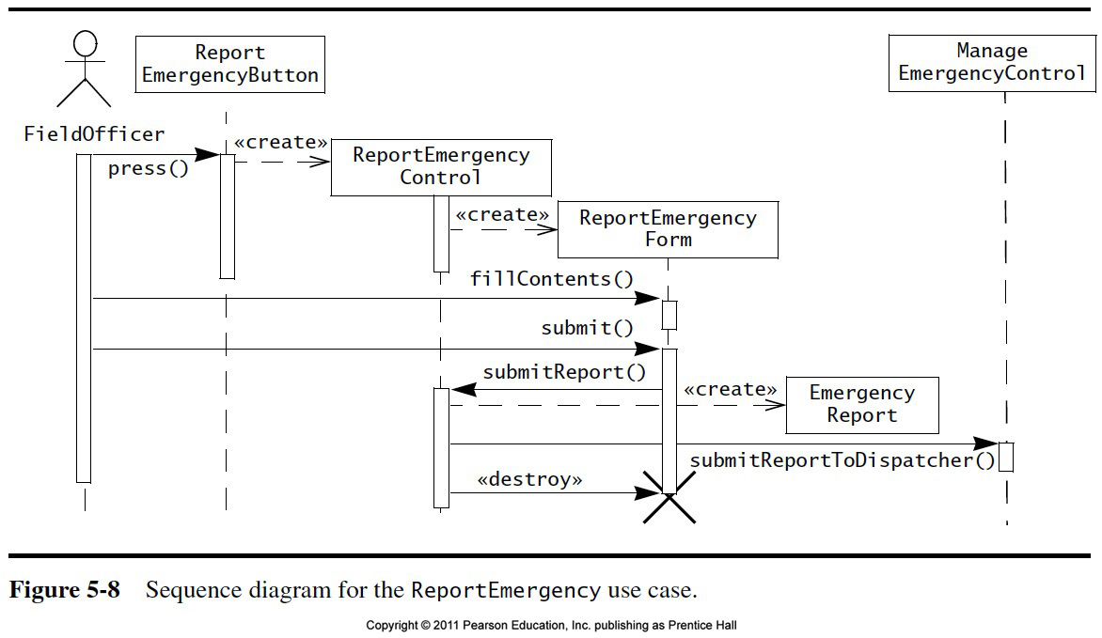

Slide 71
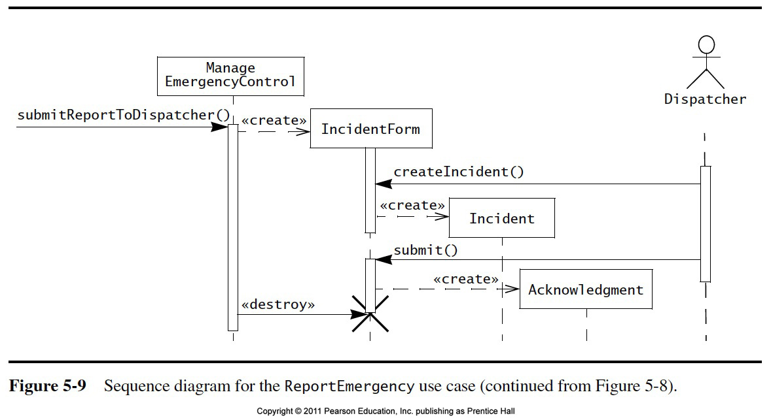

Slide 72
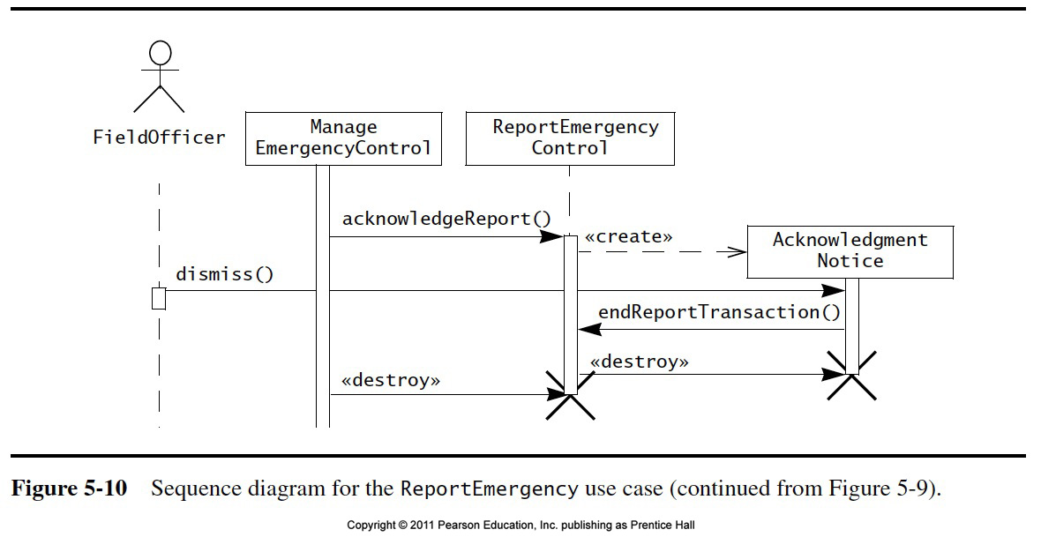

Slide 73
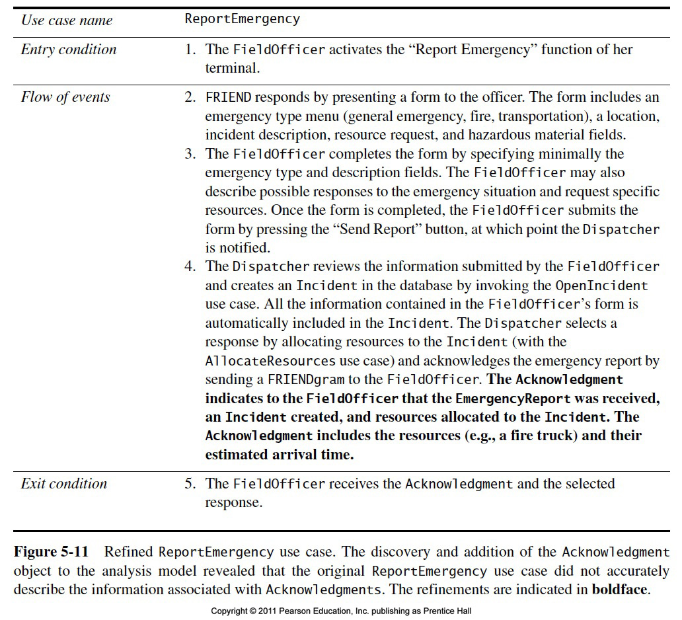

Slide 74
Heuristics for Sequence Diagrams
Layout:
1st column: Should be the actor of the use case
2nd column: Should be a boundary object
3rd column: Should be the control object that manages the rest of the use case
Creation of objects:
Create control objects at beginning of event flow
The control objects create the boundary objects
Access of objects:
Entity objects can be accessed by control and boundary objects
Entity objects should not access boundary or control objects.
Notes:
Access of objects
Entity objects are accessed by control and boundary objects
Entity objects should never access boundary or control objects:
This makes it easier to share entity objects across use cases and makes entity objects resilient against technology-induced changes in boundary objects.

Slide 75
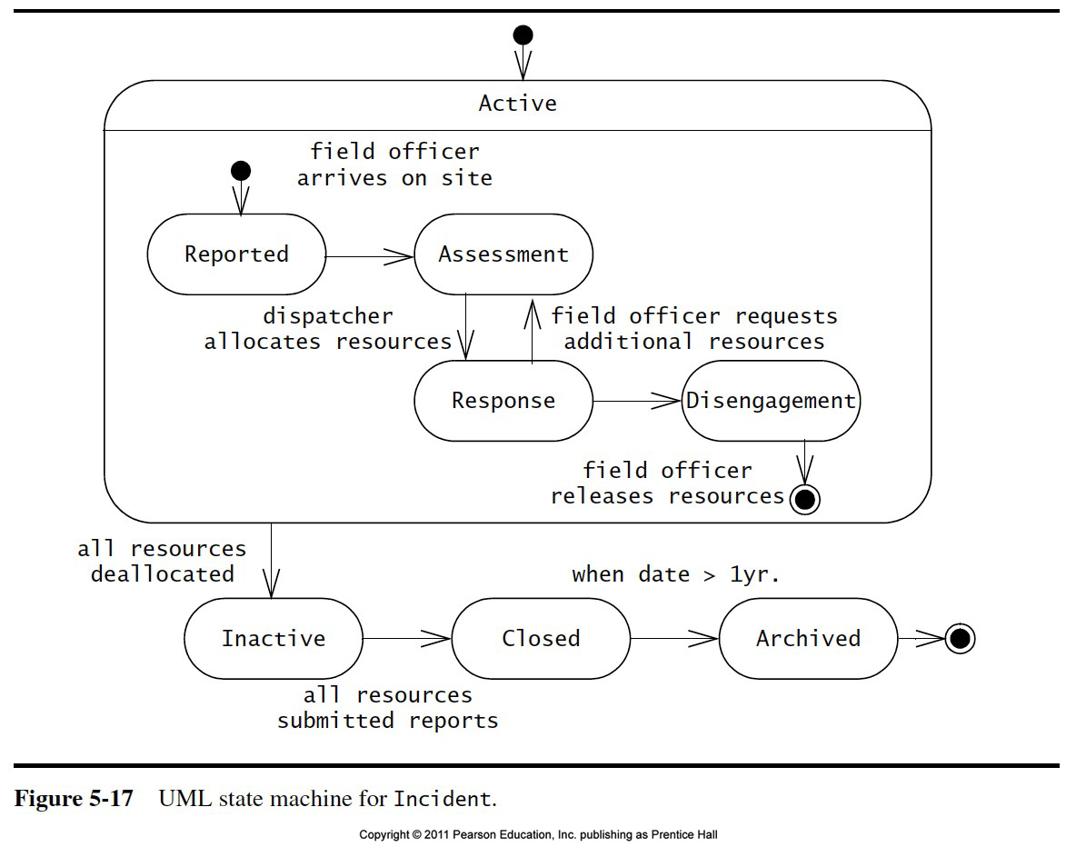
Dynamic Modeling
We distinguish between two types of operations:
Activity: Operation that takes time to complete
associated with states
Action: Instantaneous operation
associated with events
A state chart diagram relates events and states for one class
An object model with several classes with interesting behavior has a set of state diagrams
Notes:
A state diagram relates events and states for one object. It is a Graph whose nodes are states
and whose directed arcs are transitions labeled by event names
A transition is drawn from
State diagrams would be quite useless if they only describe event patterns. A behavioral description of an object must specify what the object does in response to events. This is specified in operations attached to states and transition .
An activity is an operation that takes time to complete. Activities are always associated with a state. The notation do Activity1 within a state box indicates that activity A start on entry to the state and stops when complete.
Sometimes it is more advantageous to associate an action with a state. When? When all the state transitions cause the same action, it is a better notational convenience to list the action only once. This reduces clutter in the state diagrams.
An action is an instantaneous operation. This is of course a relative notion. What we mean by instantaneous is that the duration of the operation is insignificant when compared to the time resolution of the state diagram. It also means we do not care about the internal structure of this operation. An action is therefore associated with an event.

Slide 76
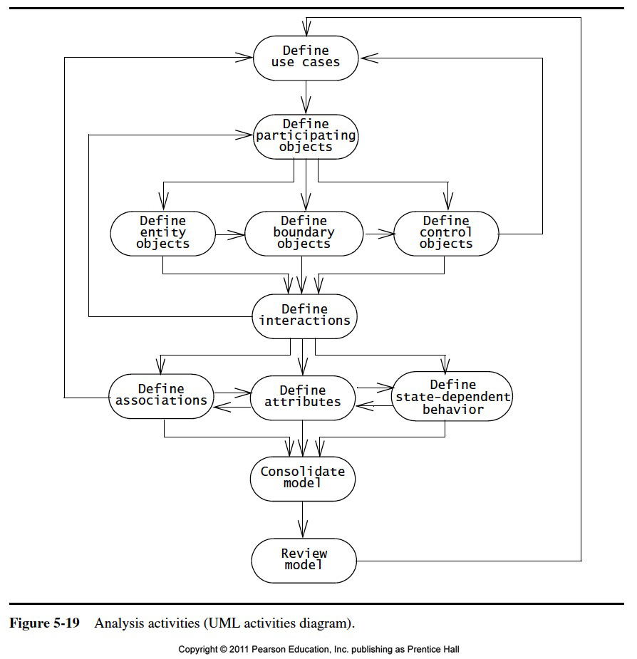

Slide 77
Practical Tips for Dynamic Modeling
Construct dynamic models only for classes with significant dynamic behavior
Avoid “analysis paralysis”
Consider only relevant attributes
Use abstraction if necessary
Look at the granularity of the application when deciding on actions and activities
Reduce notational clutter
Try to put actions into superstate boxes (look for identical actions on events leading to the same state).
Notes:
A few practical tips.
The most important one: If you have a couple of hundred objects, that does not necessarily mean that you have a couple of hundred dynamic models.
Only those objects with significant dynamic behavior need to be modeled dynamically.
Also, if two objects have the same dynamic behavior, it is often only necessary to model one of these objects with a dynamic model and then describe with a single sentence that the same dynamic model applies to both objects.
The Power and Headlight classes from our Mini People Mover are a good example. Only one of them needs to be modeled dynamically, because they both have the same identical dynamic behavior.
Because the states are permutations over different values of attribute settings, it is important to use abstraction if necessary to filter out irrelevant attributes. That is, if an attribute is not contributing to the dynamic behavior of an object, it does not have be modeled in the dynamic model. This often helps in reducing the number of states of the state diagram for the object.
What makes up an action and what makes up an activity is relative, as we have already discussed earlier. If in doubt, it is always better to model something first as an action, unless somebody points out that it has internal structure which is relevant for the application, or it has a duration which is significant with respect to the overall lifetime of the object. Example: An alarm “Propulsion System Failure” should be modeled as an activity, because the propulsion system will most probably be down for a while after such a failure.

Slide 78
Let’s Do Analysis: A Toy Example
Analyze the problem statement
Identify functional requirements
Identify nonfunctional requirements
Identify constraints (pseudo requirements)
Build the functional model:
Develop use cases to illustrate functional requirements
Build the dynamic model:
Develop sequence diagrams to illustrate the interaction between objects
Develop state diagrams for objects with interesting behavior
Build the object model:
Develop class diagrams for the structure of the system

Slide 79
Problem Statement: Direction Control for a Toy Car
Power is turned on
Car moves forward and car headlight shines
Power is turned off
Car stops and headlight goes out.
Power is turned on
Headlight shines
Power is turned off
Headlight goes out
Power is turned on
Car runs backward with its headlight shining
Power is turned off
Car stops and headlight goes out
Power is turned on
Headlight shines
Power is turned off
Headlight goes out
Power is turned on
Car runs forward with its headlight shining

Slide 80
Find the Functional Model: Use Cases
Use case 1: System Initialization
Entry condition: Power is off, car is not moving
Flow of events:
1. Driver turns power on
Exit condition: Car moves forward, headlight is on
Use case 2: Turn headlight off
Entry condition: Car moves forward with headlights on
Flow of events:
Driver turns power off, car stops and headlight goes out.
Driver turns power on, headlight shines and car does not move.
Driver turns power off, headlight goes out
Exit condition: Car does not move, headlight is out

Slide 81
Use Cases continued
Use case 3: Move car backward
Entry condition: Car is stationary, headlights off
Flow of events:
Driver turns power on
Exit condition: Car moves backward, headlight on
Use case 4: Stop backward moving car
Entry condition: Car moves backward, headlights on
Flow of events:
Driver turns power off, car stops, headlight goes out.
Power is turned on, headlight shines and car does not move.
Power is turned off, headlight goes out.
Exit condition: Car does not move, headlight is out

Slide 82
Use Cases Continued
Use case 5: Move car forward
Entry condition: Car does not move, headlight is out
Flow of events
Driver turns power on
Exit condition:
Car runs forward with its headlight shining

Slide 83
Use Case Pruning
Do we need use case 5?
Let us compare use case 1 and use case 5:
Use case 1: System Initialization
Entry condition: Power is off, car is not moving
Flow of events:
Driver turns power on
Exit condition: Car moves forward, headlight is on
Use case 5: Move car forward
Entry condition: Car does not move, headlight is out
Flow of events
Driver turns power on
Exit condition:
Car runs forward with its headlight shining

Slide 84
Dynamic Modeling: Create the Sequence Diagram
Name: Drive Car
Sequence of events:
Billy turns power on
Headlight goes on
Wheels starts moving forward
Wheels keeps moving forward
Billy turns power off
Headlight goes off
Wheels stops moving
. . .

Slide 85
Sequence Diagram for Drive Car Scenario
:Headlight
Billy:Driver
:Wheel
Power(on)
Power(on)
Power(off)
Power(off)
Power(on)
Power(on)

Slide 86
Toy Car: Dynamic Model
Wheel
Headlight
Forward
Off
power
power
off
on
power
power
off
on
Stationary
Stationary
On
power
power
on
off
Backward
Notes:
Change arrows for Headlight states in opposite directions.
Then ask question: Anybody sees what is wrong with the slide? In many cases the students will identify the arrows pointing in the wrong direction.

Slide 87
Toy Car: Object Model
Car
Power
Headlight
Wheel
Status: (On, Off)
Status: (On, Off)
Motion: (For
ward,
Backward,
TurnOn()
Switch_On()
Stationary)
TurnOff()
Switch_Off()
Star
t_Moving()
Stop_Moving()
Notes:
Headlight
Status: (On, Of)f
Switch_On()
Switch_Of
f()
Power
Status: (On, Off)
TurnOn()
TurnOff()
Train
Let them find the key abstractions: Operator, Train. Then the 3 objects in the train: Power, Headlight, Wheel. Then show that the Power and Headlight objects operate the same way, so only one object is needed to for the event scenario.

Slide 88
Review Of the Analysis Model
The analysis model is built incrementally and iteratively
Several iteration with the client and the user are needed before analysis model finalized
If any omission discovered, additional use cases might be required
After the analysis model becomes stable, then the model must be reviewed by;
Developer
By developer and client
The goal is to make sure the model is correct, complete, consistent, and clear

Slide 89
Cont.. Review Of the Analysis Model
The following questions should be asked to ensure that the model is correct
Is the glossary of the entity objects understandable by the user
Does the abstract classes correspond to user-level concepts
Are all the descriptions in accordance with users’ definitions?
Do all the entity and boundary objects have meaningful noun phrases and names?
Do all the use cases and control objects have meaningful verb phrases and names?
Are all error cases described and handled?

Slide 90
The following questions should be asked to ensure that the model is complete
For each object:
Can it be accessed from a boundary object?
Is it needed by any use cases?
In which use case is it created modified? Destroyed?
For each attribute:
When is it set? What is its type? Should is be a qualifier?
For each association:
When is it traversed? Why was the specific multiplicities chosen?
For each control objects:
Does it have the necessary associations to access the objects participating in its corresponding use case?

Slide 91
The following question should be asked to ensure the model is consistent:
Are there multiply use cases and classes with the same name?
Do the entities with the similar names denote similar concepts?
Are there objects with similar attributes and associations that are not in the same generalization hierarchy?

Slide 92
The following questions must be asked to ensure the model is realistic
Are there any novel features in the system?
Is the system is feasible ?
Can the performance and reliability requirements be met?

Slide 93
When is a Model Dominant?
Object model:
The system has classes with nontrivial states and many relationships between the classes
Dynamic model:
The model has many different types of events: Input, output, exceptions, errors, etc.
Functional model:
The model performs complicated transformations (eg. computations consisting of many steps).
Which model is dominant in these applications?
Compiler
Database system
Spreadsheet program

Slide 94
Examples of Dominant Models
Compiler:
The functional model is most important
The dynamic model is trivial because there is only one type input and only a few outputs
Is that true for IDEs?
Database systems:
The object model most important
The functional model is trivial, because the purpose of the functions is to store, organize and retrieve data
Spreadsheet program:
The functional model most important
The dynamic model is interesting if the program allows computations on a cell
The object model is trivial.
Notes:
Compiler:
The functional model most important. The compiled program must execute correctly if the input was a correct program.
The dynamic model is trivial because there is only one type input and only a few outputs.
Database systems:
The object model most important.
The functional model is trivial, because the purpose of the functions is to store, organize and retrieve data.
Spreadsheet program:
The functional model most important.
The dynamic model is interesting if the program allows computations on a cell.
The object model is trivial, because the spreadsheet values are trivial and cannot be structured further. The only interesting object is the cell.

Slide 95
Managing Analysis
Documenting Analysis
Assigning Responsibility
Communicating about Analysis
Iteration Over the Analysis Model

Slide 96
Requirements Analysis Document Template
1. Introduction
2. Current system
3. Proposed system
3.1 Overview
3.2 Functional requirements
3.3 Nonfunctional requirements
3.4 Constraints (“Pseudo requirements”)
3.5 System models
3.5.1 Scenarios
3.5.2 Use case model
3.5.3 Object model
3.5.3.1 Data dictionary
3.5.3.2 Class diagrams
3.5.4 Dynamic models
3.5.5 User interfae
4. Glossary

Slide 97
Section 3.5 System Model
3.5.1 Scenarios
- As-is scenarios, visionary scenarios
3.5.2 Use case model
- Actors and use cases
3.5.3 Object model
- Data dictionary
- Class diagrams (classes, associations, attributes and operations)
3.5.4 Dynamic model
- State diagrams for classes with significant dynamic behavior
- Sequence diagrams for collaborating objects (protocol)
3.5.5 User Interface
- Navigational Paths, Screen mockups

Slide 98
Requirements Analysis Questions
1. What are the transformations?
Create scenarios and use case diagrams
- Talk to client, observe, get historical records
Functional Modeling
2. What is the structure of the system?
Create class diagrams
- Identify objects.
What are the associations between them?
What is their multiplicity?
- What are the attributes of the objects?
- What operations are defined on the objects?
Object Modeling
3. What is its behavior?
Create sequence diagrams
- Identify senders and receivers
Show sequence of events exchanged between objects.
Identify event dependencies and event concurrency.
Create state diagrams
- Only for the dynamically interesting objects.
Dynamic Modeling
Notes:
The textbook has a relatively elaborate dynamic model for a programmable thermostat. To get the concept through to you and to show the relation to the object model, I would like to use an even simpler example: The movement of a toy train.

Slide 99
Assigning Responsibility
End use -> generate information about the system
Client -> an integration role, defines the scope of the system
Analyst-> Application domain export, models the system
Architect-> an integration role, unifies the use cases and object models from a system point of view.
Document editor-> responsible to integrate documents
Configuration manager-> responsible for maintaining a revision history of the documents
Reviewer-> validate the system

Slide 100
Communicating about Analysis
Challenging during requirements elicitation and analysis
Different background of participants
Different Expectation
New terms
Define clear territories
Define clear objectives

Slide 101
Iteration Over the Analysis Model
Analysis occur Iteratively and incrementally
Brainstorming
Solidification-> define the boundary of the system and a set of standard term
Maturity
Client Sign Off
Client sign of represents the acceptance of the analysis model
Client and developer agree on:
A list of priorities
A revision process
A list of criteria that will be used to accept or reject the system
A schedule and a budget

Slide 102
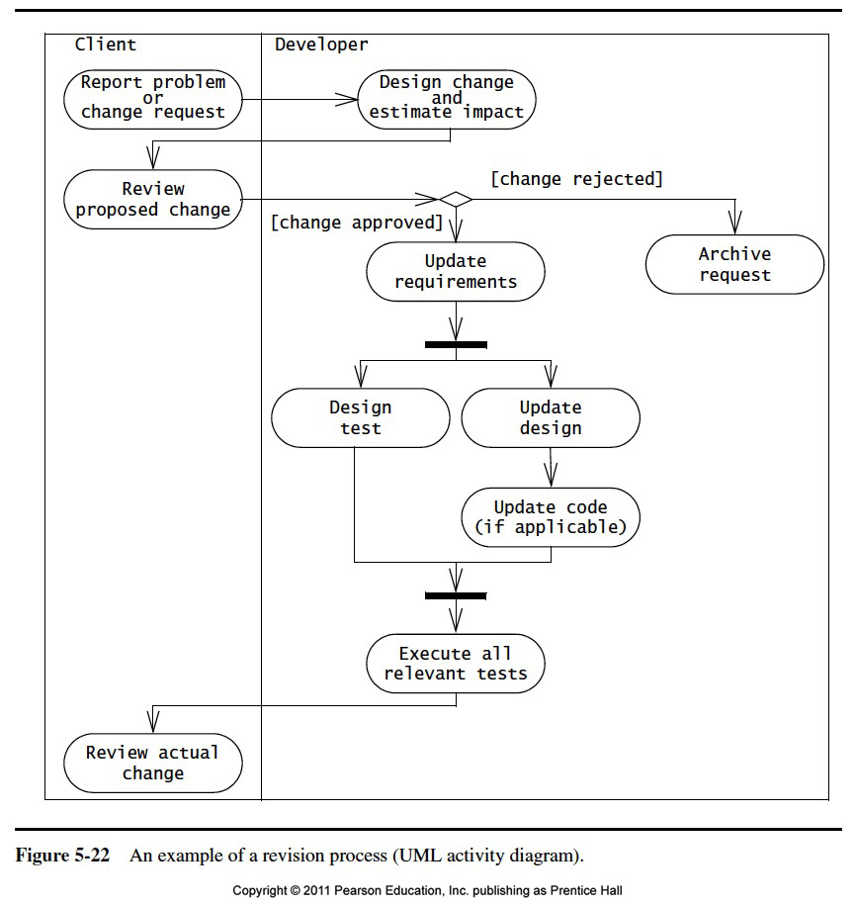

Slide 103
Analysis Summary

Slide 104
END

